Slide 1
Adult Positioning- “M”- working to correct a “fixed position”.
Progress report- Dec 06 to Sept 07

Slide 2
M has spastic quadriplegia as a result of an acquired brain injury ten years previously. He had been stabbed in the abdomen and lost so much blood that he had hypoxia to the brain.
M has generalised increased muscle tone, which is particularly severe in his lower limbs and right upper limb. He is unable to change is position in bed or to readjust his position when seated.
M has some voluntary movement in his left upper limb but cannot use this movement purposefully. He has intellectual impairment but does have limited speech.
When first seen in Dec 2006, M had fixed hip and knee flexion in legs, a stiff trunk and very tight flexion in his right arm and wrist. These joint positions could not be passively changed due to the forces required. Care staff found it very difficult to perform hoist transfers on M as he could not be flexed forward in his wheelchair in order to position the sling behind him due to his stiff trunk and hips.

Slide 3
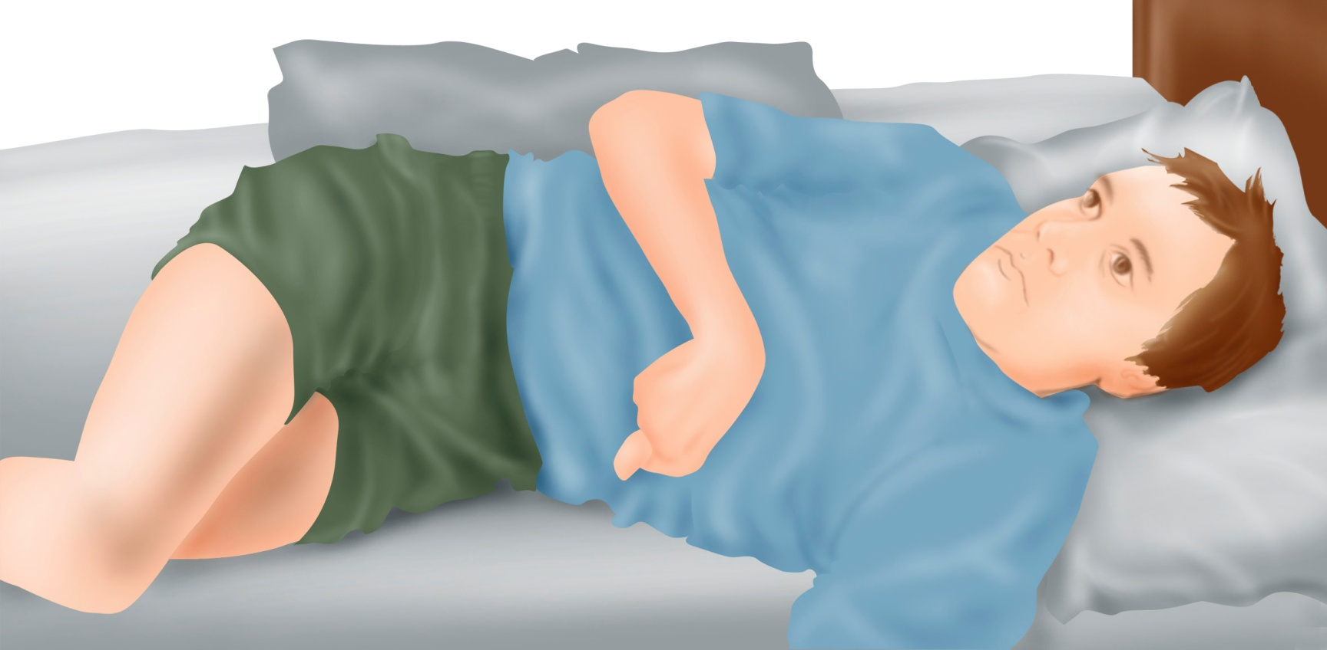
M would sleep in the same posture all night unable to move his position. He would have very disturbed sleep and wake very early in the morning making groaning and moaning noises. Staff would have to get him out of bed early due to his discomfort.

Slide 4
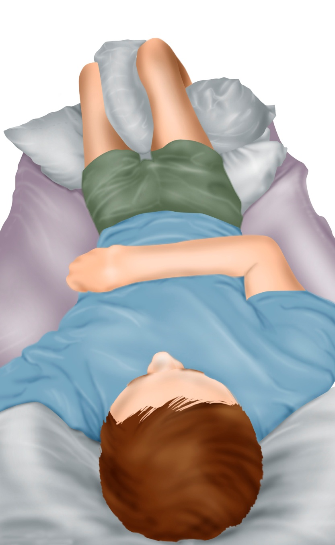
Symmetrisleep equipment was put in place for M in Dec 2006 . had some fixed windsweeping deformity of his hips at this stage, which meant that this had to be accommodated within the equipment. It was possible to get symmetrical alignment of his chest and pelvis if his windsweeping was accommodated. Three large pillows were required to support his hips and knees in their flexed posture giving even weight distribution and allowing for relaxation.
This equipment was used nightly and M’s posture monitored regularly.

Slide 5
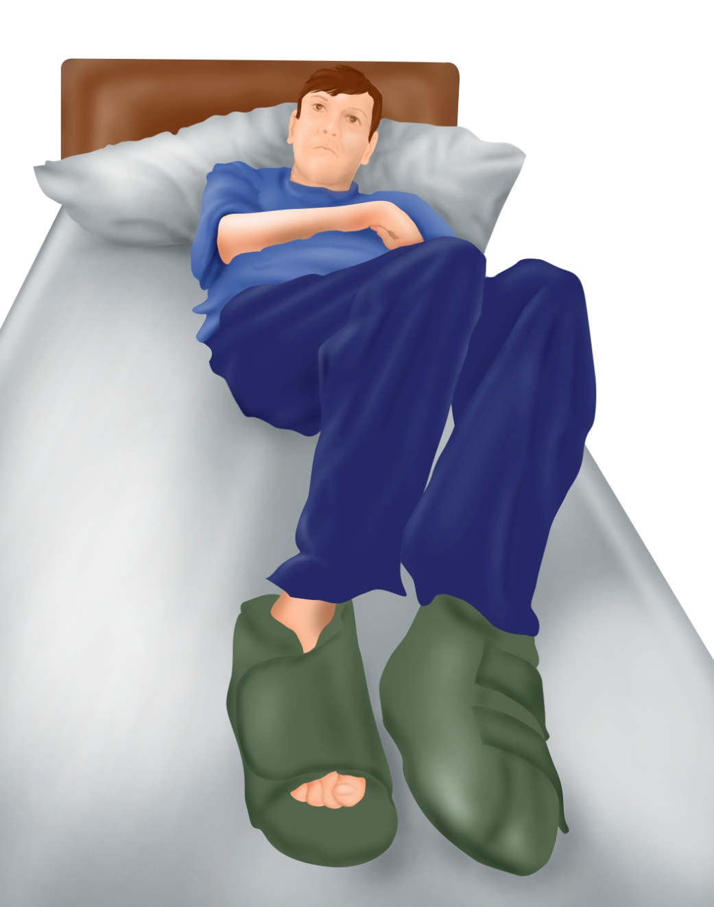
This image shows the changes in M’s posture in bed, without any support, after three months of using the equipment (Feb 2007)
M’s hips and knees were a little less flexed and his windsweeping had reduced significantly. At this stage, M no longer woke frequently during the night and did not moan and groan in discomfort in the early morning. M was sleeping well and had to be woken by staff to get up. He was much more alert and happier during the day and staff reported that he was less stiff and thus transfers were much easier.

Slide 6
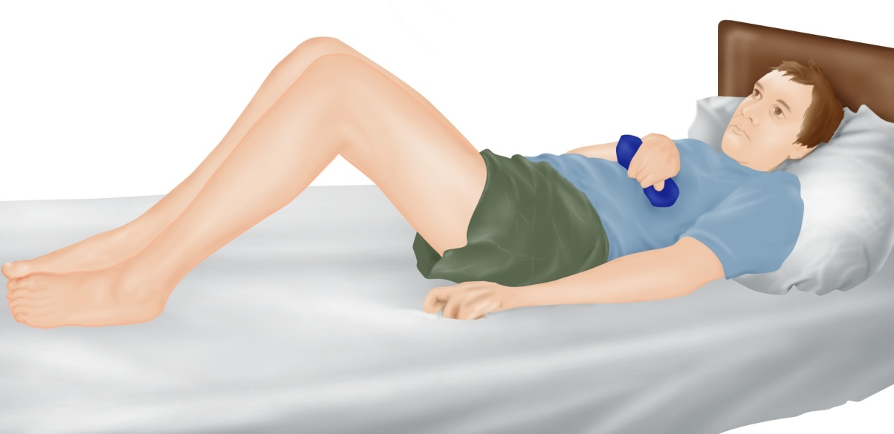
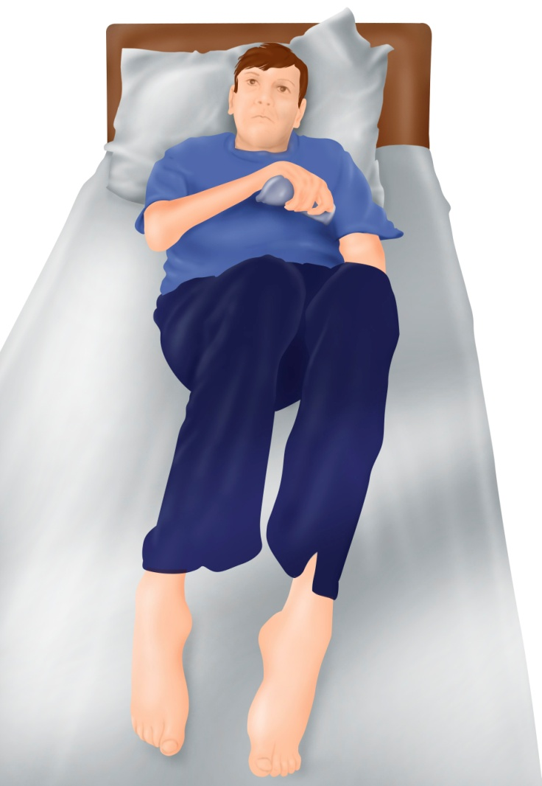
With continued use, M’s posture improved even further.
By Sept 07,M was almost symmetrical in his trunk and pelvis when lying in bed without support. The degree of flexion in his hips and knees was reduced. He was sleeping well and was much more relaxed during the day. Accompanying changes had taken place with his seating insert as he was now able to weight bear symmetrically now and required a less complex seating cushion. Staff found it much easier to perform personal care and transfers.

Slide 7
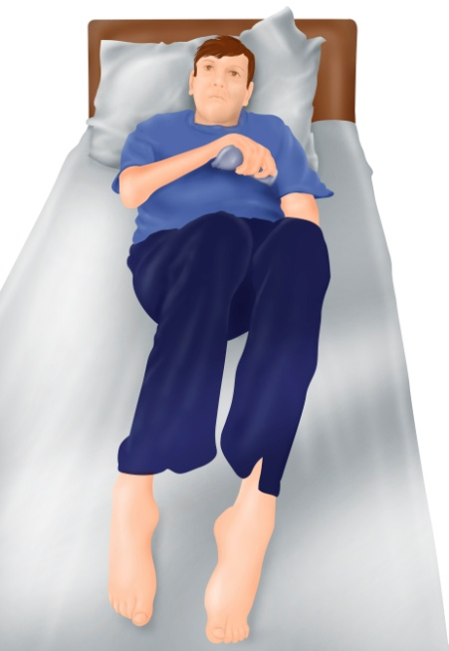
M still uses his system. He has brackets at chest and hips and a couple of pillows under the knees.
Update: (February 2010)
About the author:
Cheryl is a Physiotherapist who manages an equipment service for a non-government disability organisation in WA. She has worked in the disability field for the past twenty years.
©2010Cheryl Lockwood – text
©2010Symmetrikit Engineering Ltd- Illustrations

